Slide 1














Robotic Project presentation
Presented by : Yiren QIU
Ghous Iqbal

Slide 2

Project PART1 Requirement
The topic of Section 1 is "Autonomous Driving of a Ground Differential Robot by Perception." This section requires us to first gain a clear understanding of the ROS (Robot Operating System) system, including its internal interaction logic. Secondly, it demands familiarity with the Turtlebot3 hardware and the ability to effectively perform operations such as camera calibration, which are not necessary in the Gazebo simulation environment, and to efficiently integrate with the ROS system.

Slide 3
PART 1
Ideation process
01
02
03
04
Advanced ROS Programming Techniques: Learning to read, analyze, and modify Python or C code files within the ROS environment.
Turtlebot3 Hardware Study: Gaining knowledge of the sensors available on the Turtlebot3 and the necessary hardware calibration.
Integration of Turtlebot3 with ROS: Applying the cascading method between Turtlebot3 and the ROS system to complete the entire first phase of the task.
ROS Fundamentals Learning: Understanding the interaction between components of the ROS system.

Slide 4
In a ROS-based system, nodes are the basic units responsible for specific tasks like sensor data acquisition, motion control, or data processing. By dividing the system into these nodes, ROS facilitates modular design and parallel execution.
Importance: Nodes enable a distributed and scalable architecture, facilitating integration and testing of individual components.
01.
ROS Fundamentals Learning
ROSNode
Topics are named communication channels used for message passing between nodes. Nodes can publish data to a topic or subscribe to a topic to receive data.
Importance: Topics decouple communication between nodes, allowing for flexibility and reusability of system components.
02.
ROSTopic
Robot Operating System (ROS) is an open-source framework used for robotics software development. It simplifies the creation of complex robot behavior by providing tools, libraries, and conventions. Although it is not an actual operating system, it operates as a middleware, facilitating communication between different parts of a robotic system.
Services in ROS provide synchronous communication, where one node can send a request and receive a response from another node. This is different from topics, which are asynchronous and continuous. Services are used for on-demand communication.
Importance: Services are critical for implementing request-response interactions, such as querying sensor states or sending commands.
03.
ROSService

Slide 5
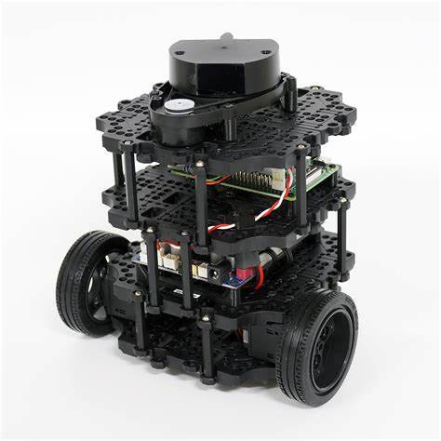
Turtlebot 3
TurtleBot3 is an affordable, versatile robot platform developed by ROBOTIS and the Open Source Robotics Foundation (OSRF). Primarily used for education, research, and prototyping, it's popular among robotics beginners and professionals. It's highly integrated with the Robot Operating System (ROS), ideal for learning and experimenting with ROS concepts.

Slide 6

PART 1 Results
About to put video here.

Slide 7
Project PART 2 Requirement
The topic of Section 2 is "Doing autonomous driving by doing SLAM and create the autorace map." This section requires us to further deepen our understanding of the Turtlebot3 hardware's self-positioning and its position within the reference world, as well as to learn the extraction methods. Additionally, it prompts us to study the SLAM task and poses a challenge: how to transform flat lane markings into obstacles within the SLAM map?

Slide 8
PART 2
Ideation process
01
02
03
04
SLAM Method Learning: By practical use and method reading, understand which existing SLAM libraries can be applied to this task.
SLAM Method Analysis: Gain theoretical understanding of how SLAM identifies obstacles and projects them onto the map.
Turtlebot3 Hardware Learning: Understand the sensors available on the Turtlebot3 and the necessary hardware calibration.
Integration of Turtlebot3 with SLAM Method and ROS System: Complete this part of the task, addressing the primary issue of converting a 2D track into obstacles in the SLAM map.

Slide 9
95%
We almost near the answer!
Through the analysis of the SLAM task logic and based on the existing understanding of the intrinsic parameters of the Turtlebot3, the reference world coordinate system, and other related information, we have devised a solution to the problem of converting two-dimensional planar lines from the real world into obstacles in the SLAM task map. The approach involves creating an additional file to store all pixel points representing lines detected along the vehicle's path (for simplicity, we select one pixel point out of every 100). The SLAM program operates normally without any modifications. After completing the exploration of the entire map, the SLAM-detected map is stored. Finally, a script is designed to map the previously stored pixel points onto the detected map, manually setting their pixel values to 0 (which appears as black in the map, representing obstacle pixels).

Slide 10
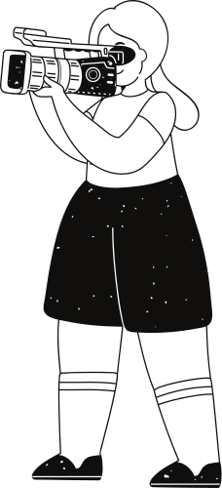
Development of a LaneDetector Class for Video Stream Processing
Localization Functions for Pixel Position Compensation
To obtain pixel data of two-dimensional lines, we meticulously analyzed the video acquisition and processing methods in the DetectLane file and independently designed an additional LaneDetector Class to handle video streams resubscribed from the ROS system.
To compensate for the loss of pixel position, we designed an additional function, odometry_callback, to perform localization of the turtlebot itself and the get_global_pose function for localization in the world coordinate system, aiming to ensure that the final line pixel points are meaningful.
Image Processing and Coordinate System Transformation
Map Management with Storage, Extraction, and Overwrite Logic
We designed the process_image function, which, by combining the camera's intrinsic and extrinsic parameter matrices with the aforementioned information, extracted reasonable obstacle pixel positions. Considering the issue of dense pixel points, we adopted a sparse logic and successfully implemented the conversion between image coordinates, ground coordinates, robot coordinates, world coordinate systems, and SLAM map coordinate systems.
We designed storage and extraction functions for the aforementioned information and additionally developed map read-write methods to complete the overwrite logic for the SLAM map.

Slide 11

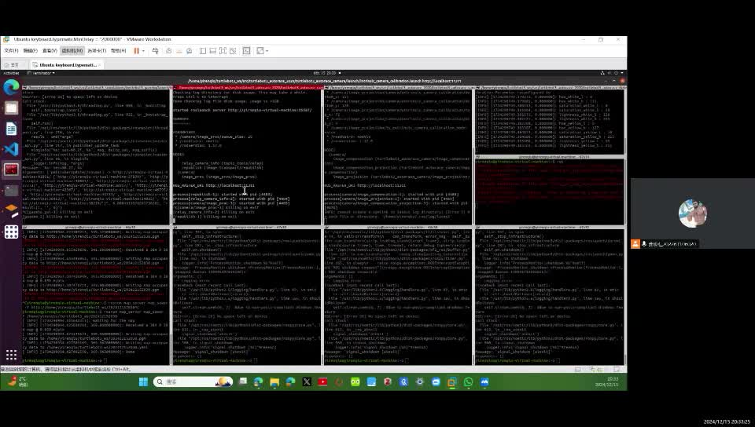
Ultimately,
What we have strived to achieve a preliminary milestone in our research.

Slide 12
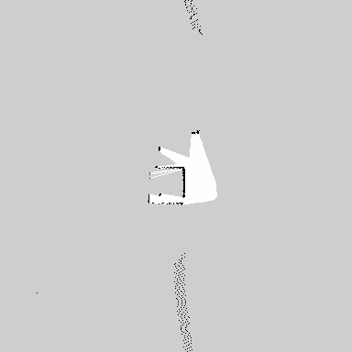
Ultimately,
What we have strived to achieve a preliminary milestone in our research.
The results, as shown in the figure on the right, ultimately indicate our failure. It is currently 9:26 PM on December 15, 2024, and the points we extracted have been overlaid on the SLAM-generated map with unsatisfactory results. However, after careful review, the positions of the obstacle points appear to be logical. It is possible that the mapping logic still contains some perplexing aspects.

Slide 13
Thank you very much!

